Slide 1
Analysis of the Ticket Pricing Strategy of Ski Resorts in the United States
Big Mountain Resort
Presented by: Adam Young

Slide 2
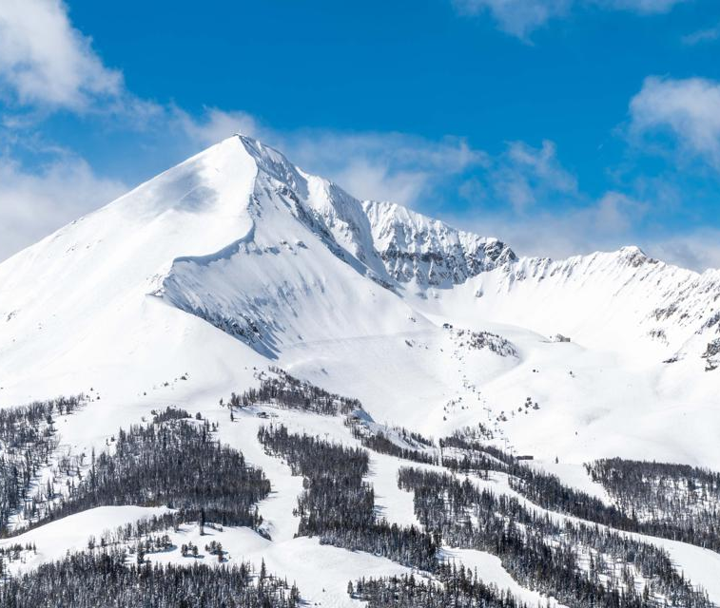
Agenda
Problem Identification
Recommendations and Key Findings
Scenario Analysis
Data
Model Selection
Conclusion

Slide 3
Problem Identification
Big Mountain Resort currently charges $81.00 for both weekend and weekday tickets
Management would like to know:
How does Big Mountain Resort’s price compare to other resorts?
What services and facilities impact the price that a resort charges for their tickets?
Based on Big Mountain Resort’s facilities, are they charging a fair price?
Facility and ticket pricing data has been provided for resorts across The United States
Big Mountain Resort has also provided multiple scenarios to be evaluated by the model once it is completed

Slide 4
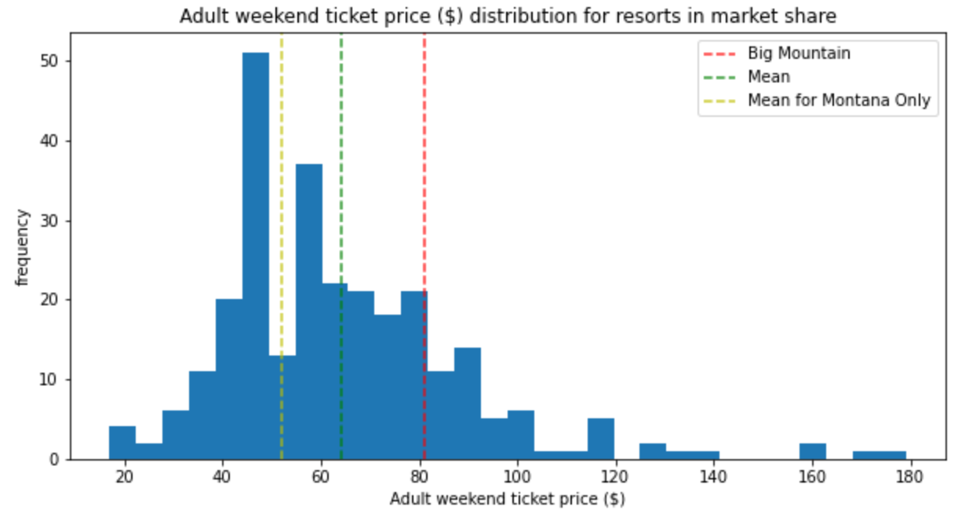
Recommendations and Key Findings
Our model recommends Big Mountain Resort charge $95.87 for tickets
This is a $14.87 increase from the current price of $81.00
The average price charged by all ski resorts in the US is $64.27, and $51.91 for ski resorts in Montana
This puts Big Mountain Resort in the highest quartile of Ski Resort Prices, even before the suggested increase to $95.87

Slide 5
Recommendations and Key Findings (Cont.)
The model identified four key variables that were related to higher ticket prices among Ski Resorts within the United States. These were:
Number of fast quad lifts
Number of total runs
Acres of snowmaking coverage
Vertical drop of runs
Big Mountain Resort was modeled to have a price of $95.87 primarily due to scoring very well in these four categories, along with some of the other minor categories.

Slide 6
Scenario Analysis
Close up to 10 runs
Closing runs would result in an expected decrease in ticket price ranging from $0 (0 runs closed) to $1.75 (10 runs closed)
Add a run, add 150 feet to vertical drop and add a chair lift
This scenario could justify a price increase of $1.99, which would result in an estimated $3.5M increase to annual revenue
Add a run, add 150 feet to vertical drop, add a chair lift and add 2 acres of snowmaking
The additional 2 acres of snowmaking does not justify a further price increase compared to the prior scenario
Increase the longest run by 0.2 miles and add 4 acres of snowmaking
According to the model, this scenario does not justify any additional increase in ticket price
Add an additional chair lift
The current proposal of adding an additional chair lift with an annual operating cost of $1.5M is not cost effective as it would only justify a price increase of $0.30, or around $500K annually

Slide 7
Data
Data was provided by Alesha Eisen, the database manager
The original dataset included 27 columns of data pertaining to 330 different ski resorts
Weekend ticket price was selected as the target variable for the model, due to having fewer missing values than weekday ticket price
Throughout the data exploration process we removed missing and inconsistent data, and generated additional features that we felt would be useful for modeling purposes
The final dataset used for modeling consisted of 36 columns of data pertaining to 277 ski resorts

Slide 8
Model Selection
Two models were constructed and tested throughout this process:
Linear regression model
Mean absolute error of 10.5 across the cross-validation data
Mean absolute error of 11.8 when applied to the test set
Random forest model
Mean absolute error of 9.6 across the cross-validation data
Mean absolute error of 9.5 when applied to the test set
With a lower mean absolute error, the random forest model tends to more accurately predict the ticket prices of the ski resorts within the dataset
Both models had similar results in terms of which resort features were important to justifying higher ticket price, but the random forest model was selected due to its greater accuracy

Slide 9
Conclusion
Based on the ticket prices of other ski resorts across The United States, Big Mountain Resort could justify increasing its current ticket price to $95.87
Big Mountain Resort’s price increase is justified by the fact that it scores well above average in all key indicators of ticket price as identified by the model:
Number of fast quad lifts
Number of runs
Acres of snowmaking
Vertical drop
Adding one chair lift at an operating cost of $1.5M annually would not be cost effective, as it would only justify a ticket increase of $0.30, or $500K annually

